Slide 1
Intro to Programming Part 3: For loops, numpy arrays, and image analysis
Keisuke Ishihara

Slide 2

Digital image
of Klea taken on my phone

Slide 3
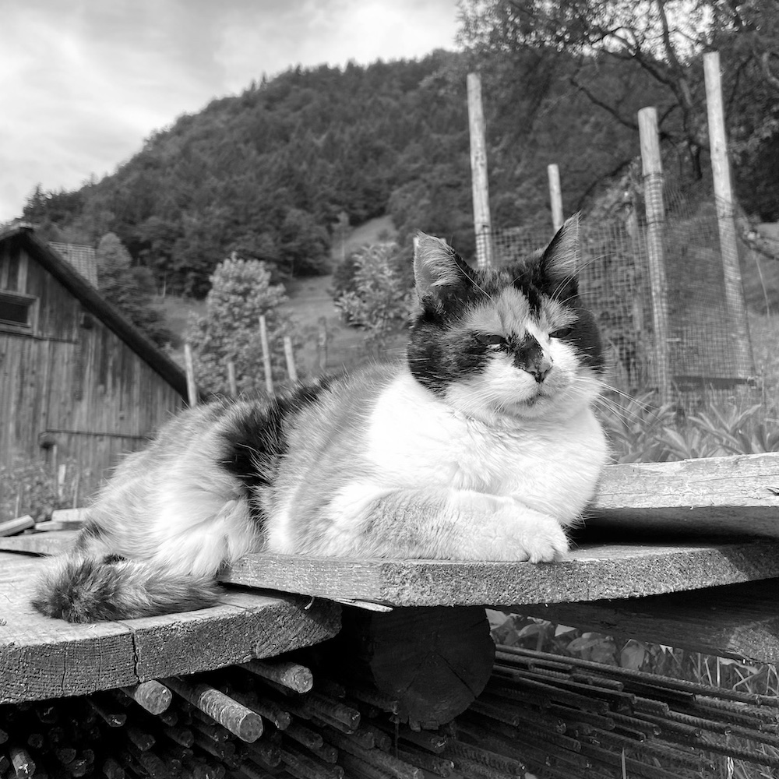
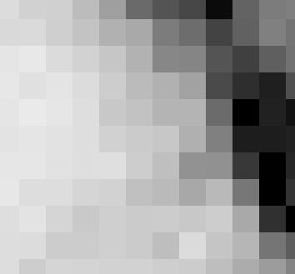
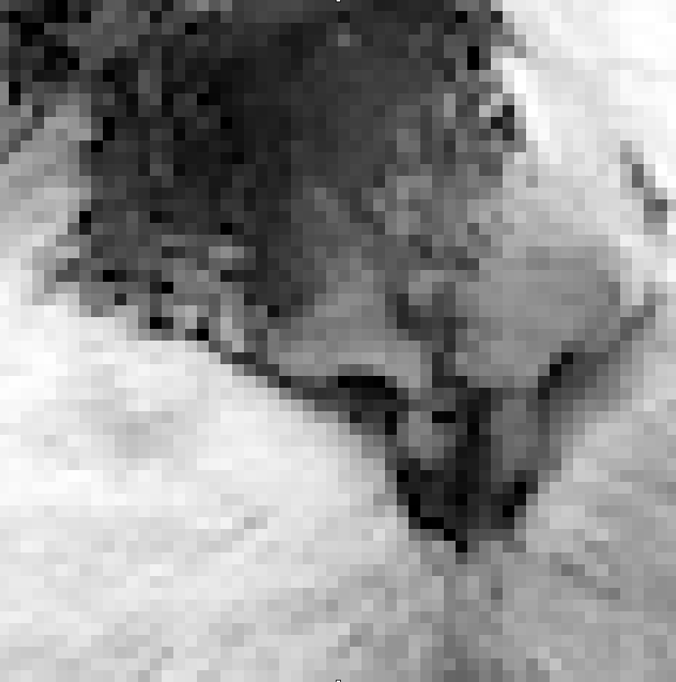

A digital image is composed of pixels
64
237
0
190
219
gray scale image
pixel

Slide 4

50 columns
50x50 pixel
8 bit
gray scale image
50 rows
matrix
8 bit contains
2^8 possible values:
0-255

Slide 5
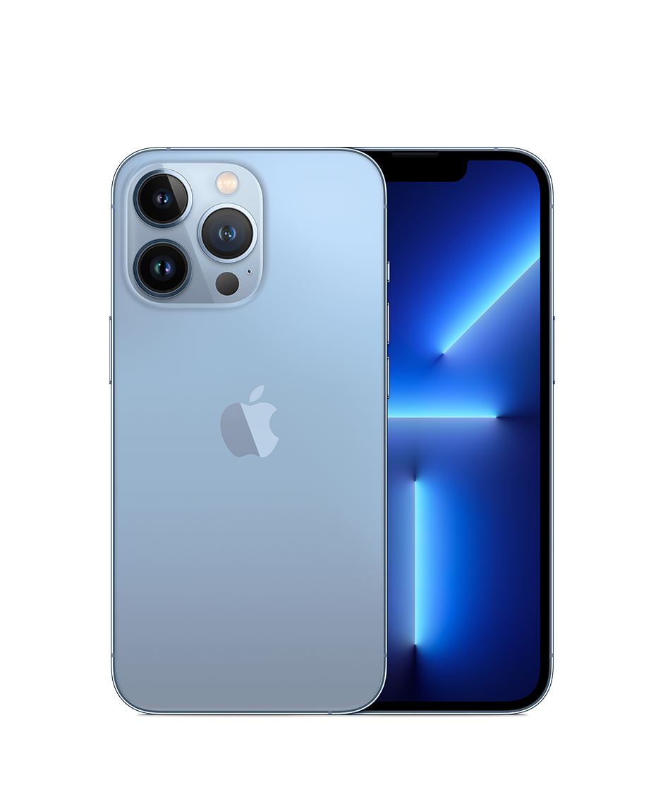
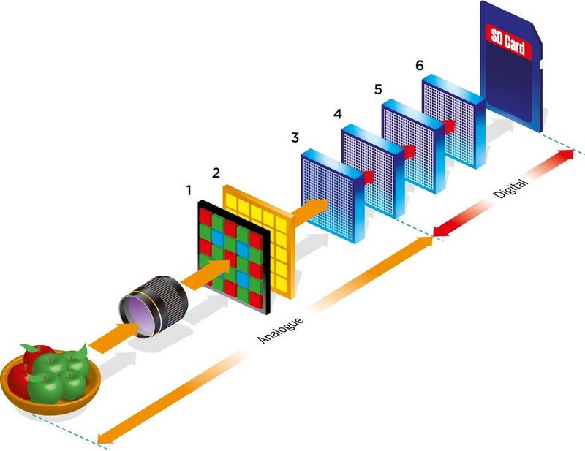
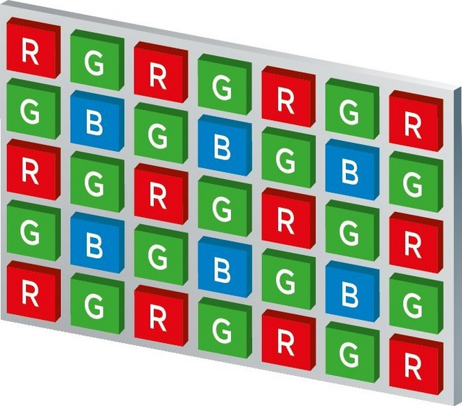
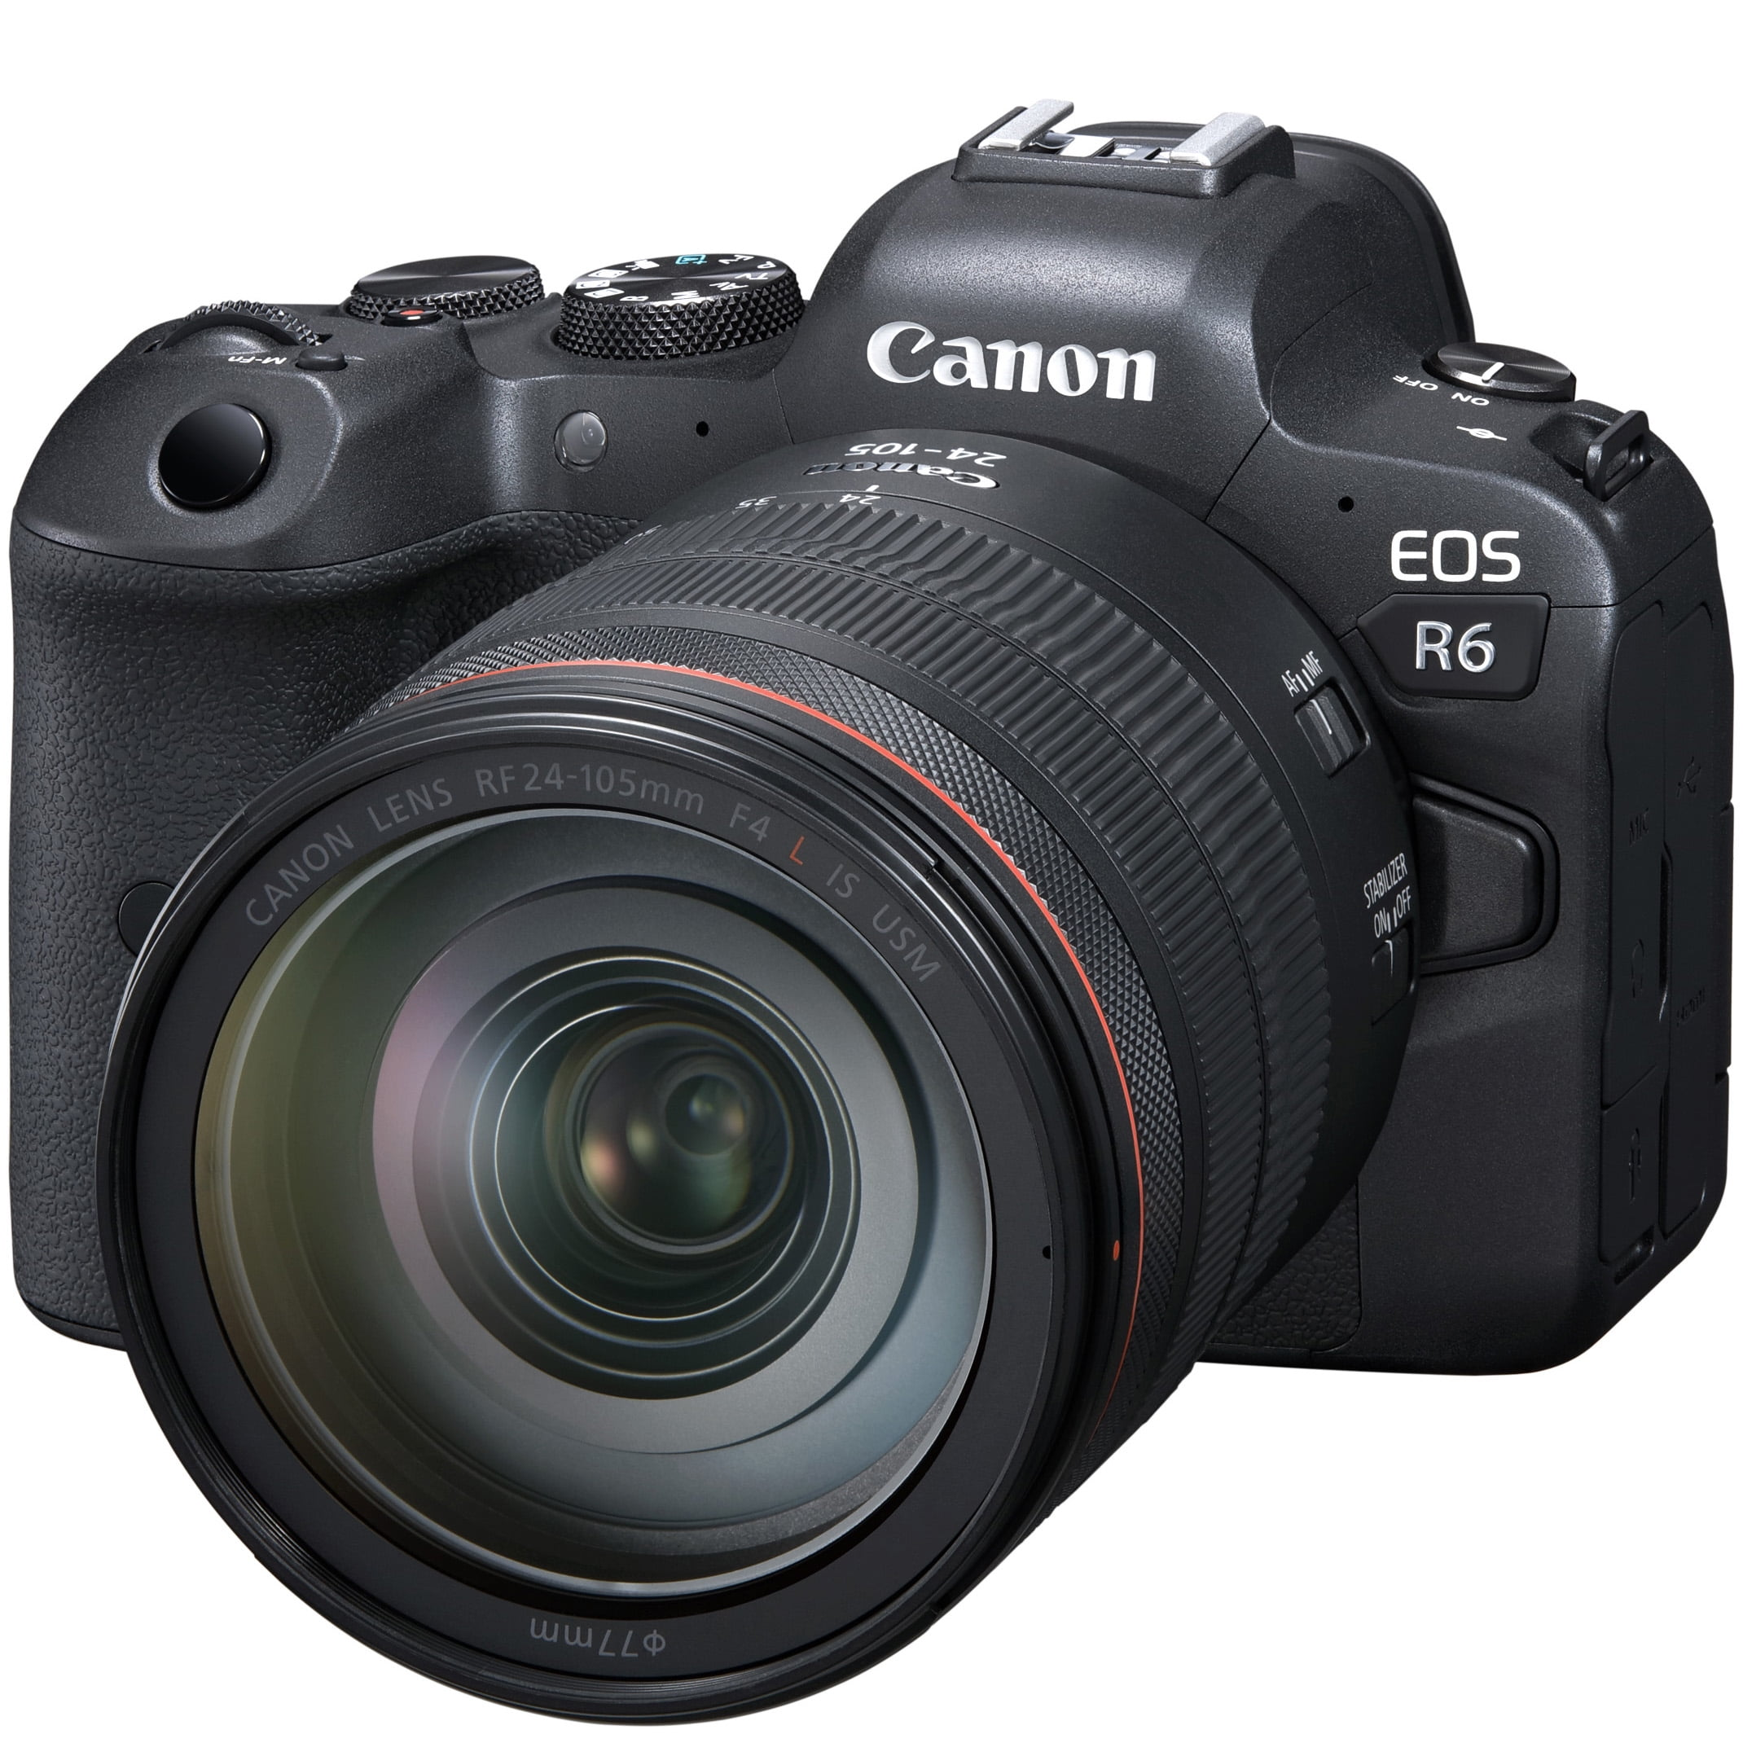
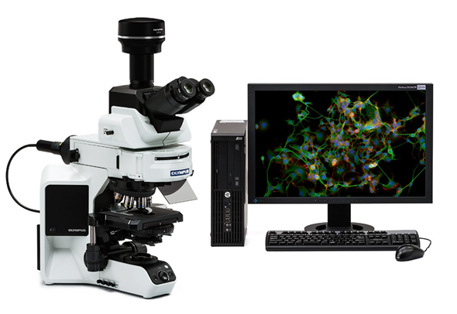
How do digital cameras work?
Red/Green/Blue color-aware sensor array converts photons to electric signals
Analog signals are digitized.
Information is stored as image files.
Today, practically all research microscopes are controlled by a computer!
https://www.canon.com.cy/pro/infobank/image-sensors-explained/

Slide 6
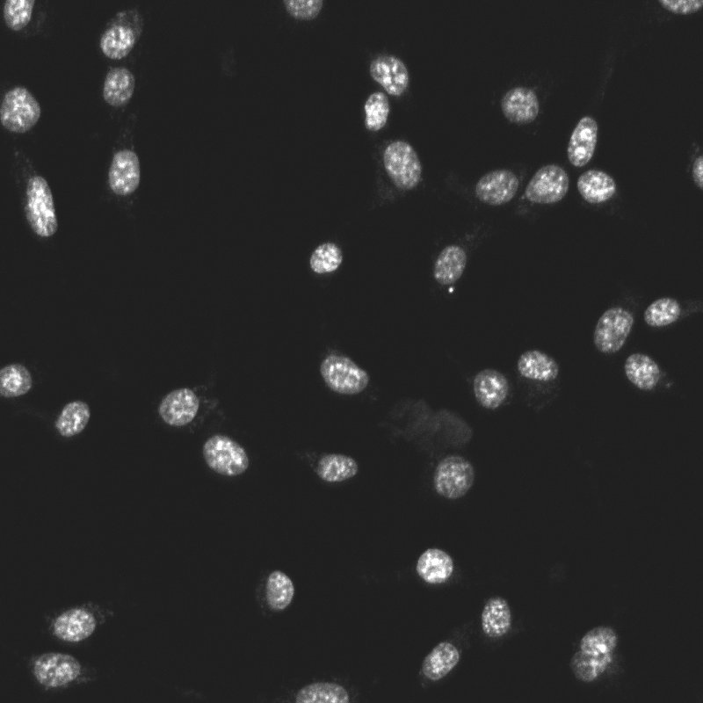
Let’s use Python to interact with digital images!
Today’s goal:
Write a program that
counts cells
measures nuclear area

